Slide 1


Monocular Depth Estimation
Team 1
Akram Khan
Brandon Wu
Darie Roman
Nada Al Aker
Depth Est.
Importance
Data Proc. & Collection
Architecture
Demo
Performance
Takeaways
Notes:
Hi Everyone, I am ___ from team one, and my teammates are _____. Our topic is monocular depth estimation, which is the challenge of converting the image or video from a single colour camera into a mapping of the depth at every point. Essentially we want to convert *next slide*

Slide 2
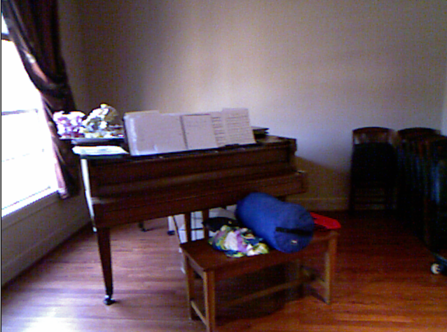
Depth Est.
Importance
Data Proc. & Collection
Architecture
Demo
Performance
Takeaways
Notes:
This *pause a bit, then next slide*

Slide 3
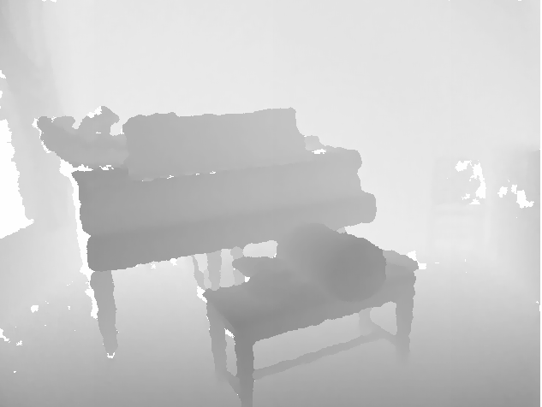
Depth Est.
Importance
Data Proc. & Collection
Architecture
Demo
Performance
Takeaways
Notes:
To this. Here is a grayscale representation of a depth map, where darker pixels show areas closer to the camera. Different colour schemes can also be used to display the same information.

Slide 4

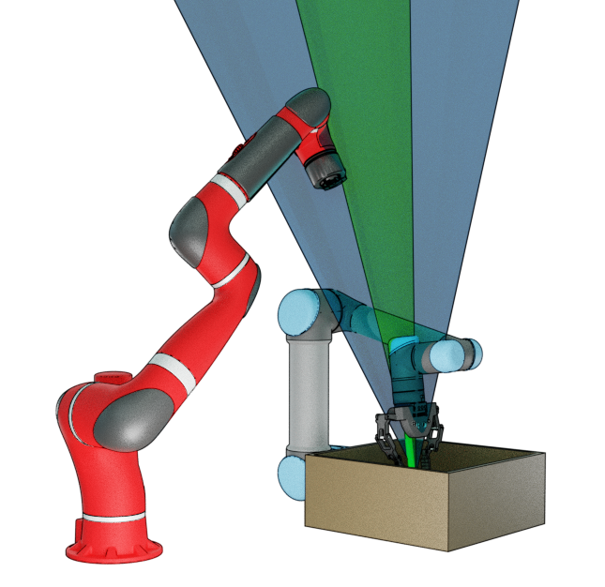

Importance of Depth Detection
Depth Est.
Importance
Data Proc. & Collection
Architecture
Demo
Performance
Takeaways
Notes:
Why does any of this matter? Well depth detection is a very important tool that provides access to 3-dimensional spatial data of our surroundings, as opposed to a 2-dimensional image. There are many use cases where it is necessary for a machine to have easy access to this information in order to understand the world around it, whether it is a vision-guided robot assembling a product, an augmented reality system, or a self-driving vehicle.

Slide 5
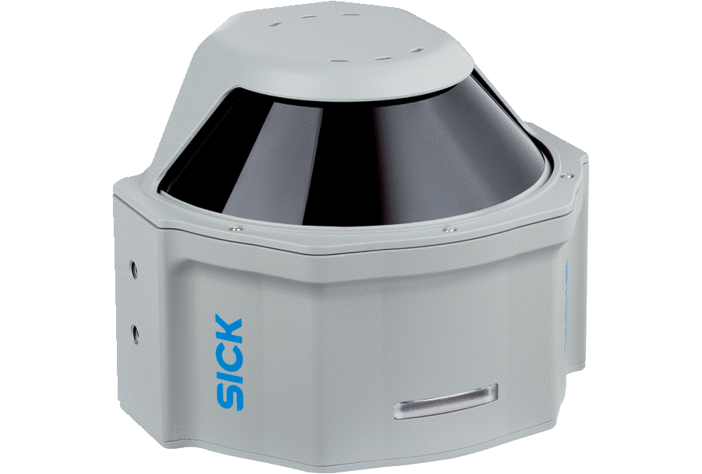
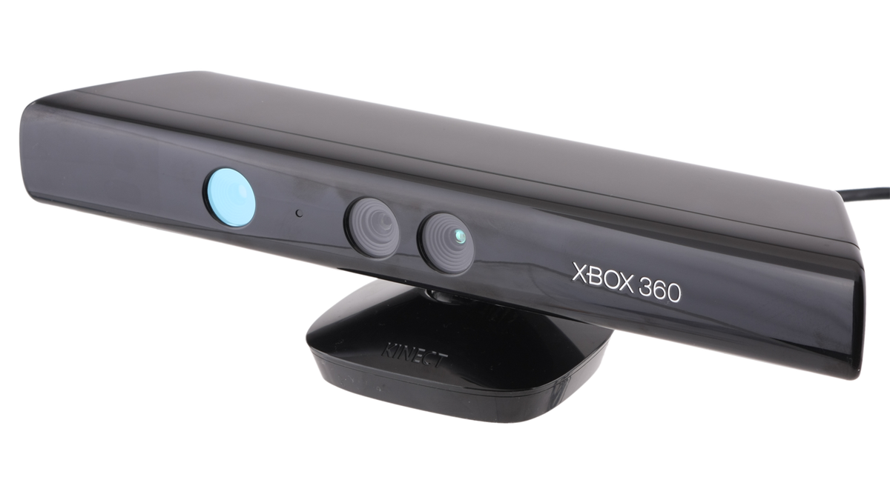
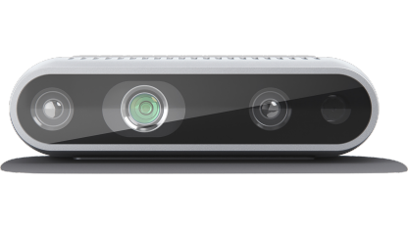
Detection vs Estimation
Depth Est.
Importance
Data Proc. & Collection
Architecture
Demo
Performance
Takeaways
Notes:
Many current solutions use bulky and expensive sensors, that employ rotating laser range finders aka LiDAR, stereo cameras, or infrared dot projectors. These sensors perform actual depth measurements to some degree, but are not easily scalable and have issues with resolution and refresh rate.

Slide 6
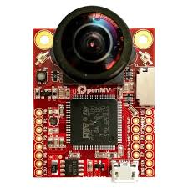
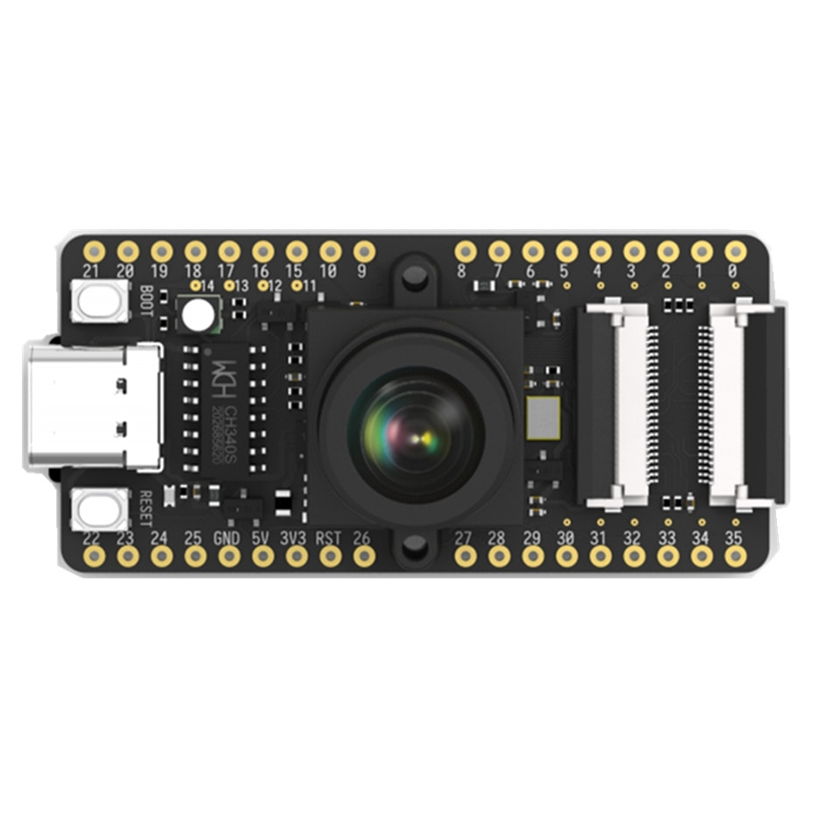
Detection vs Estimation
Depth Est.
Importance
Data Proc. & Collection
Architecture
Demo
Performance
Takeaways
Notes:
New developments in processor architecture design has led to the mass-manufacturing of very cheap TPUs or Tensor Processing Units that can perform rapid machine learning operations. So what if we can create a machine learning model to convert the color images from a camera module into fairly accurate depth maps? Well that would save a lot of space and money! But how do we design and train a model that can perform this task?

Slide 7

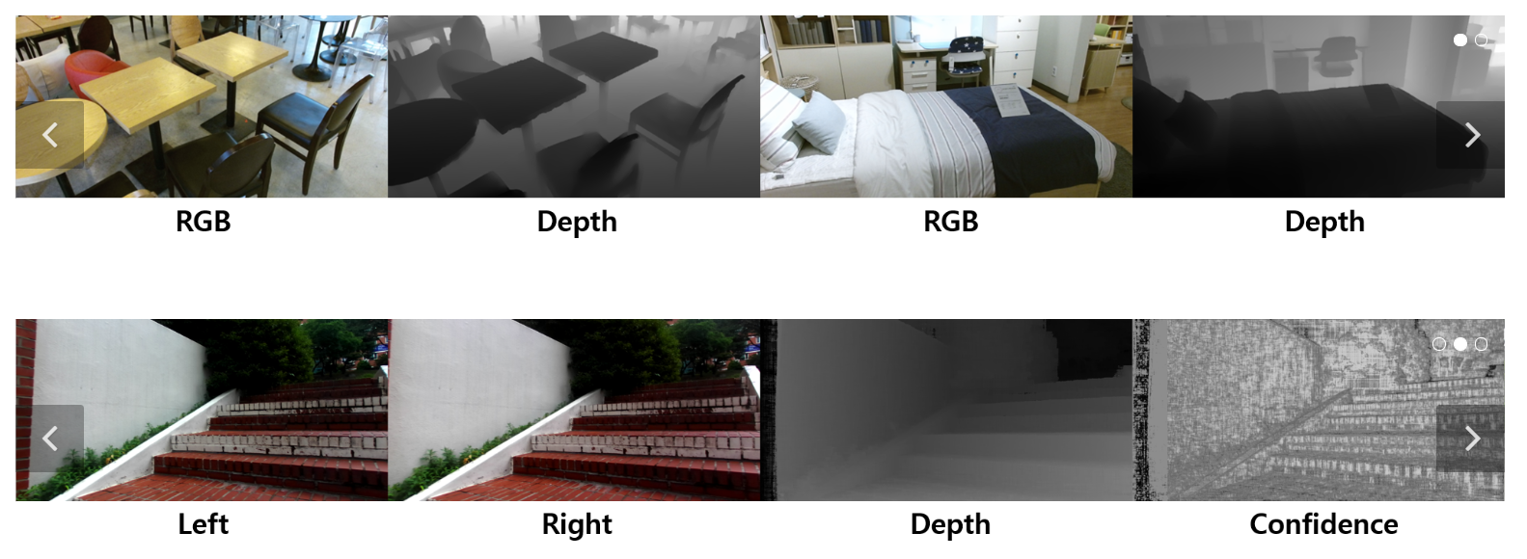
Data Collection
Notes:
Well we are going to need a lot of data. We obtained our data from the Digital Image Media Lab from Yonsei University in South Korea. They provide RGB videos of various indoor and outdoor scenes with corresponding depth maps in the form of individual image frames. In order to keep data size down, we only used 5 scenes from the indoor section. Since frames that are close together tend to be almost identical, we only kept one in 5 frames, resulting in 6 frames per second.

Slide 8
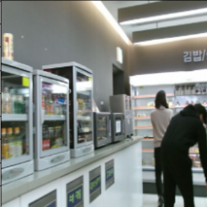
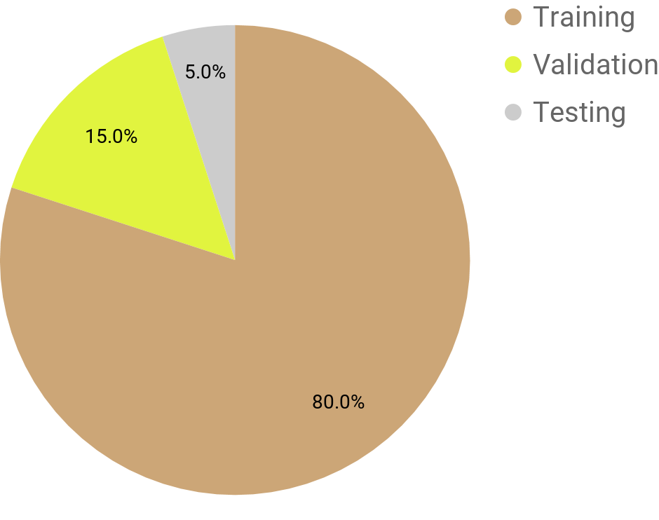
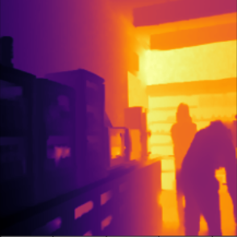
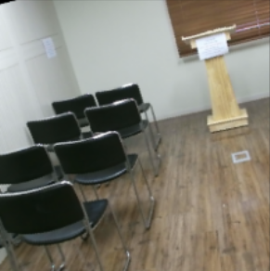
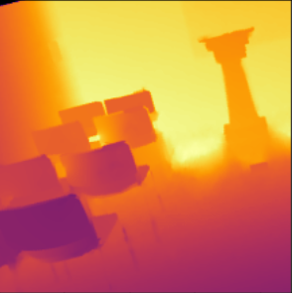
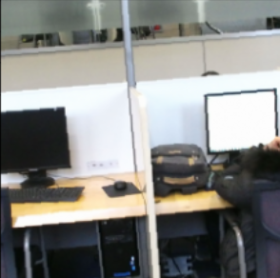
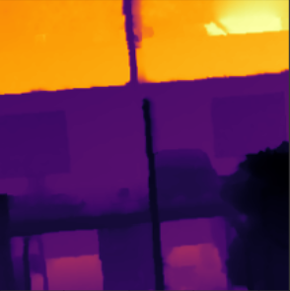
Dataset Structure
Image Pair 1
Image Pair 2
Image Pair 3
Total # of image pairs: 3611
Depth Est.
Importance
Data Proc. & Collection
Architecture
Demo
Performance
Takeaways
Notes:
Every image was paired up with its depth map, with each pair being a data point. All of the image pairs were then encoded into a single large binary file to improve loading performance. Since we wanted to avoid overlap between training, validation, and testing data, the ordered dataset was first split up into the 3 sections, after which the individual sections’ frames were shuffled. Only taking one out every 5 frames lowered the number of data points to just over 3600.

Slide 9

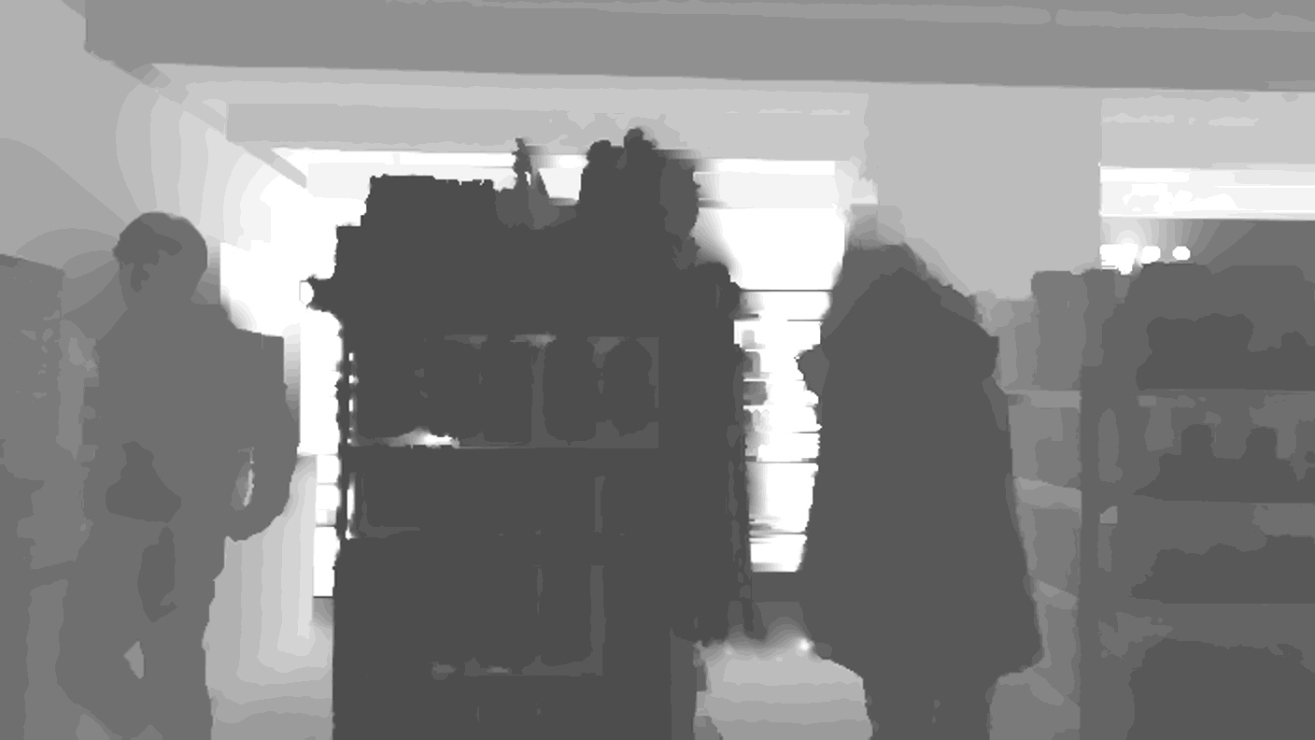
Data Augmentation
Random Paired Rotation
Random Paired Cropping
Random Paired Horizontal Flipping
640
640
224
224
480
224
480
224
Depth Est.
Importance
Data Proc. & Collection
Architecture
Demo
Performance
Takeaways
Notes:
We circumvented this by applying data augmentation to the training images. That way, every epoch will be different and we have almost unlimited data. The image pair was first randomly rotated and then center cropped to remove the black edges. The resulting image was further randomly cropped to yield a smaller portion of the image at random, and then a random horizontal flip was applied with a probability of 50%. This means that many 224 by 224 images can be extracted from the original 480 by 640 image.

Slide 10
Building the Architecture
Traditional convolutional autoencoder
Convolutional autoencoder with sequential skip connections
Conditional DCGAN with RGB Image as condition
Notes:
Now that there is plenty of good quality data, it’s time to build a machine learning model that can convert colour images into depth maps. A few architectures were tested but many fell short of this difficult task. Traditional convolutional autoencoders were not able to restore any detail from the compressed feature maps in the middle layers. When adding skip connections such that each layer receives the previous two layers, some improvements were made but GPU memory became a serious limitation. A fresh new conditional GAN-based approach was then attempted, where the generator was given an RGB image concatenated with noise, and was then asked to produce a depth map. Its loss was determined by a traditional CNN classifier. This approach proved very difficult to train, however.

Slide 11
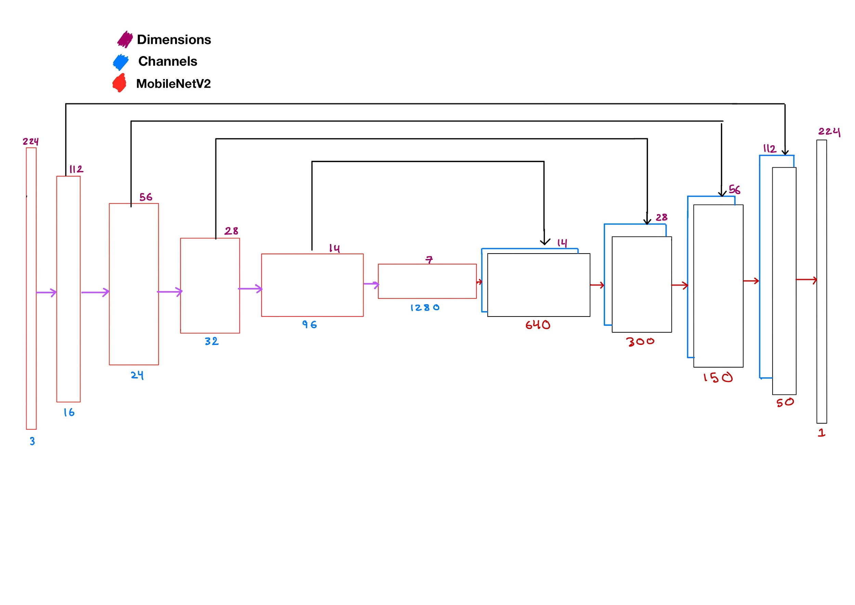
Skip Connections Auto Encoder
Note: some MobilNetV2 layers not illustrated
Depth Est.
Importance
Data Proc. & Collection
Architecture
Demo
Performance
Takeaways
Notes:
We observed a breakthrough after stumbling on a paper that suggested adding skip connections between encoder and decoder layers. We used MobileNetV2 as our encoder, and built a decoder using regular convolutions with interpolation upscaling. This model architecture allows less heavily processed features maps to have a greater impact on the final depth image. The result is that generated depth maps have much better clarity and structural detail.

Slide 12
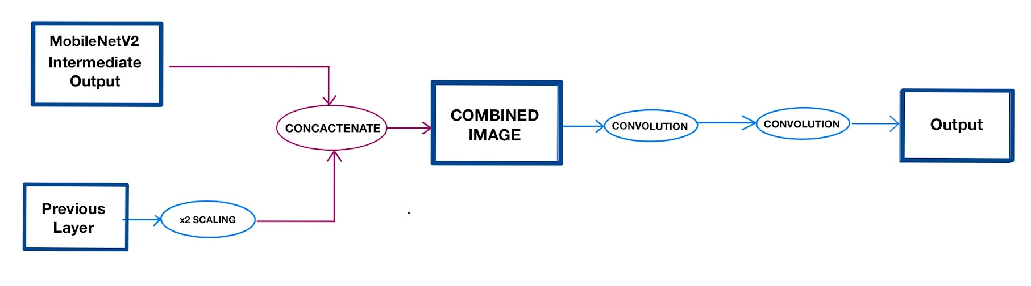
Skip Connection Module
Depth Est.
Importance
Data Proc. & Collection
Architecture
Demo
Performance
Takeaways
Notes:
The skip connection module is what allows the feature maps to bypass convolutions. This module is implemented in the decoder and receives two inputs: the previous layer, and a feature map from MobileNetV2 with twice the height and width. The former is upscaled by a factor of 2 in both dimensions in order to match the latter, after which they are concatenated together into a combined feature map. This then undergoes two layers of convolutions, and finally returns the output for the next block.

Slide 13
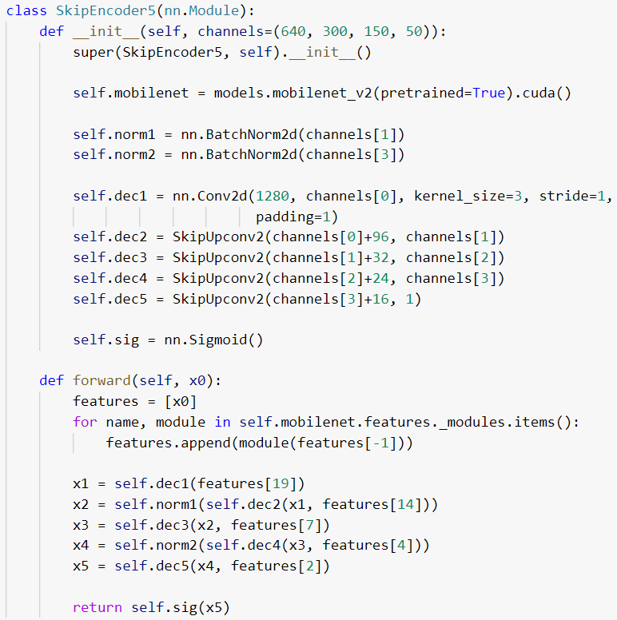
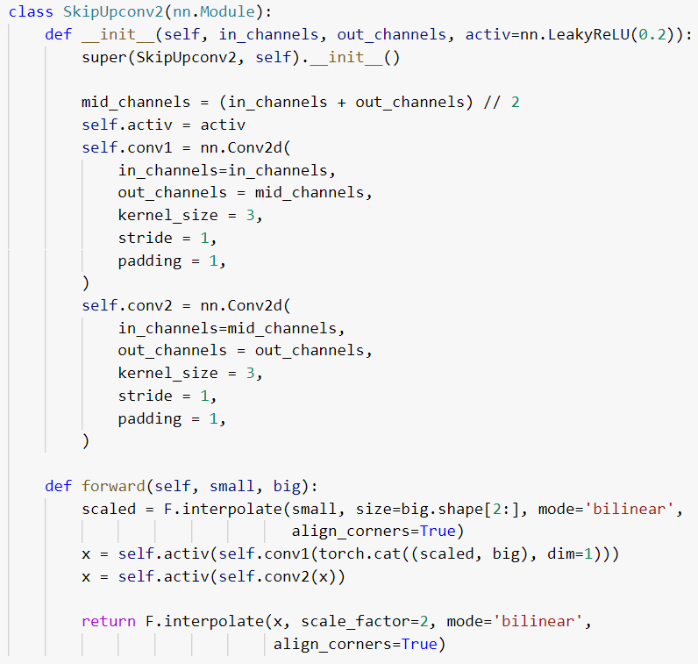
Model Skip Connection Module
Notes:
The autoencoder employs 5 decoding steps, out of which 4 receive skip connections. In its forward pass, the model appends the output from each MobileNetV2 layer for a given RGB image into a features list, which is then indexed and passed into Skip Connection blocks. These block are chained together until the image is upscaled back into the original dimensions. Two batch normalizations are also dispersed in between to smoothen the gradient descent.

Slide 14
Demonstration
Notes:
But what does all this mean? To demo our model, we fed in a video stream and reconstructed the output. We’ll let you guys decide how it went!

Slide 15
Depth Est.
Importance
Data Proc. & Collection
Architecture
Demo
Performance
Takeaways

Slide 16
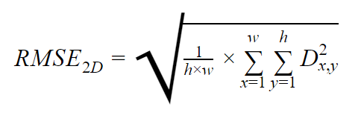
Quantitative Performance
Compare generated vs ground truth pixels
Not good for comparison with state-of-the-art
Depends on scale of data
Depth Est.
Importance
Data Proc. & Collection
Architecture
Demo
Performance
Takeaways
Notes:
The loss function we used is RMSE, or root mean squared error. Essentially, this loss function compares the generated depth map and the ground truth pixels by iterating over every coordinate and applying the equation shown.
//**getting the depth difference, squaring it, summing all of the values together, taking an average, and then square rooting the result. **//
The final loss is quite close to an average depth difference between the two images. It is worth noting that the loss depends greatly on the range of possible depth values, and so is not comparable with loss values from other datasets, unless depth normalization is done the same way.

Slide 17
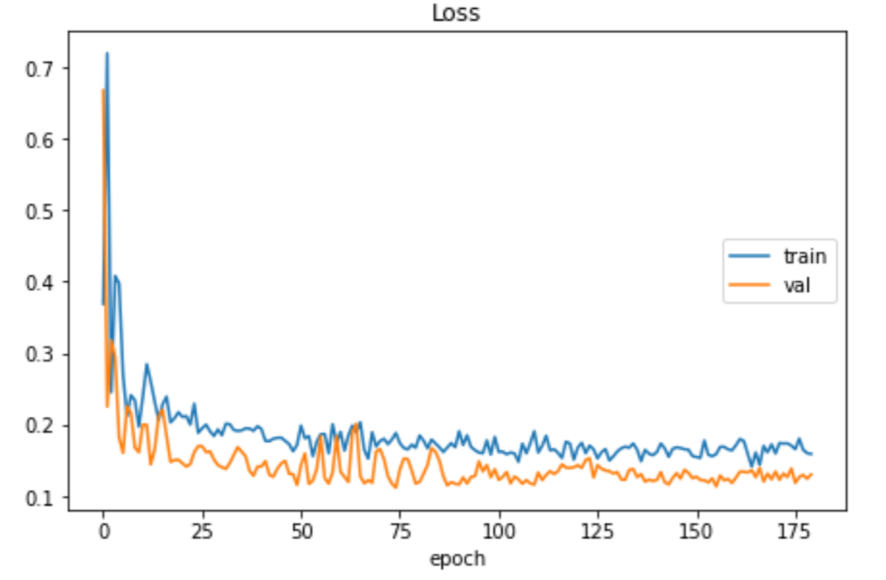
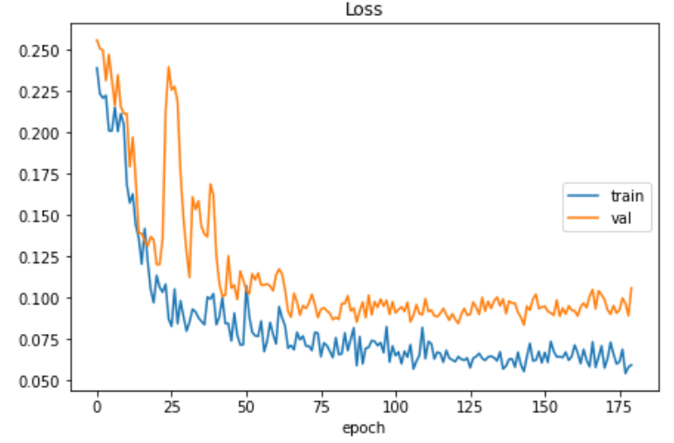
Baseline Model VS Final Model
Lowest Training Loss | 0.141
Lowest Validation Loss | 0.112
Training Time | 5:04
Lowest Training Loss | 0.054
Lowest Validation Loss | 0.083
Training Time | 21:47
Depth Est.
Importance
Data Proc. & Collection
Architecture
Demo
Performance
Takeaways
Notes:
Our final model architecture achieved a training loss almost 3 times lower than the baseline model, and a 35% lower validation loss. It did also take 4 times longer to train, but both models train very quickly compared to other CNN architectures.

Slide 18


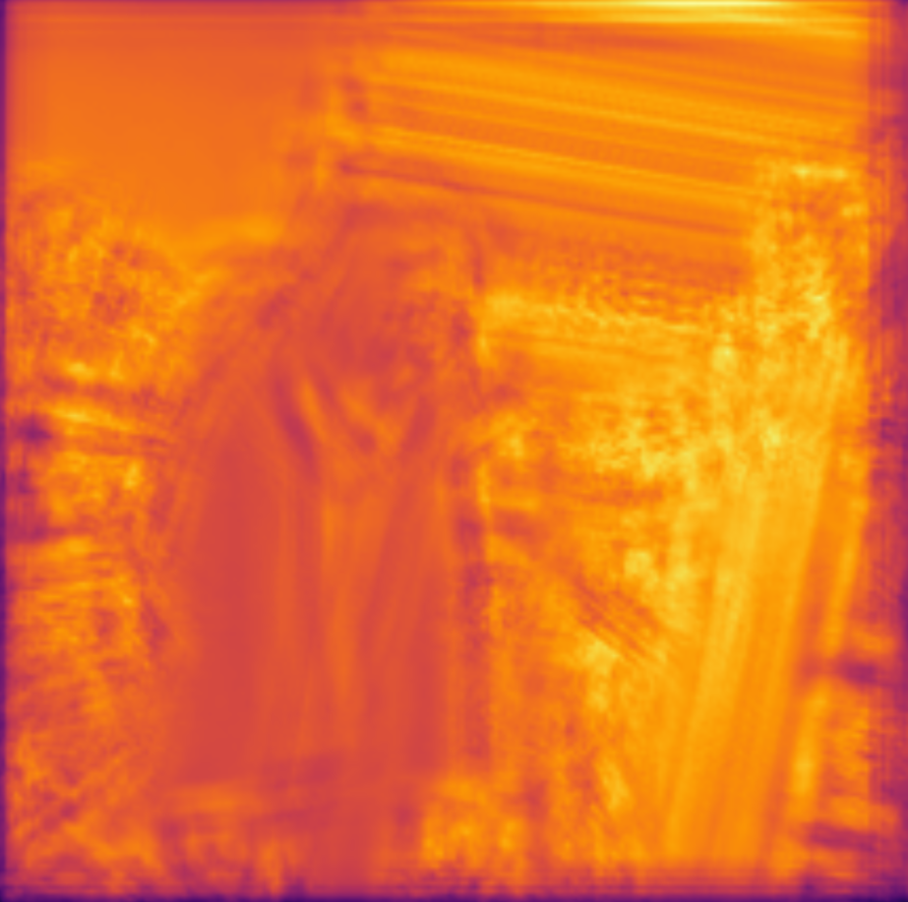
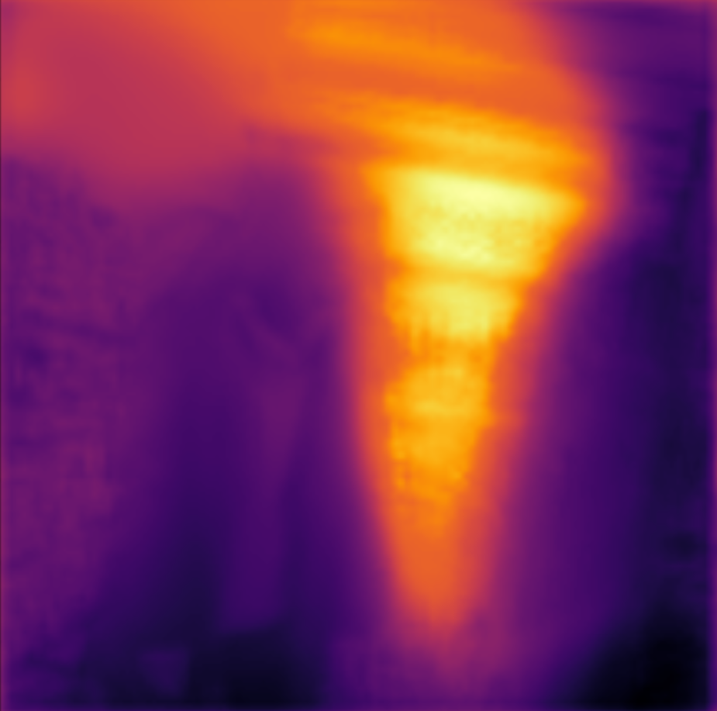

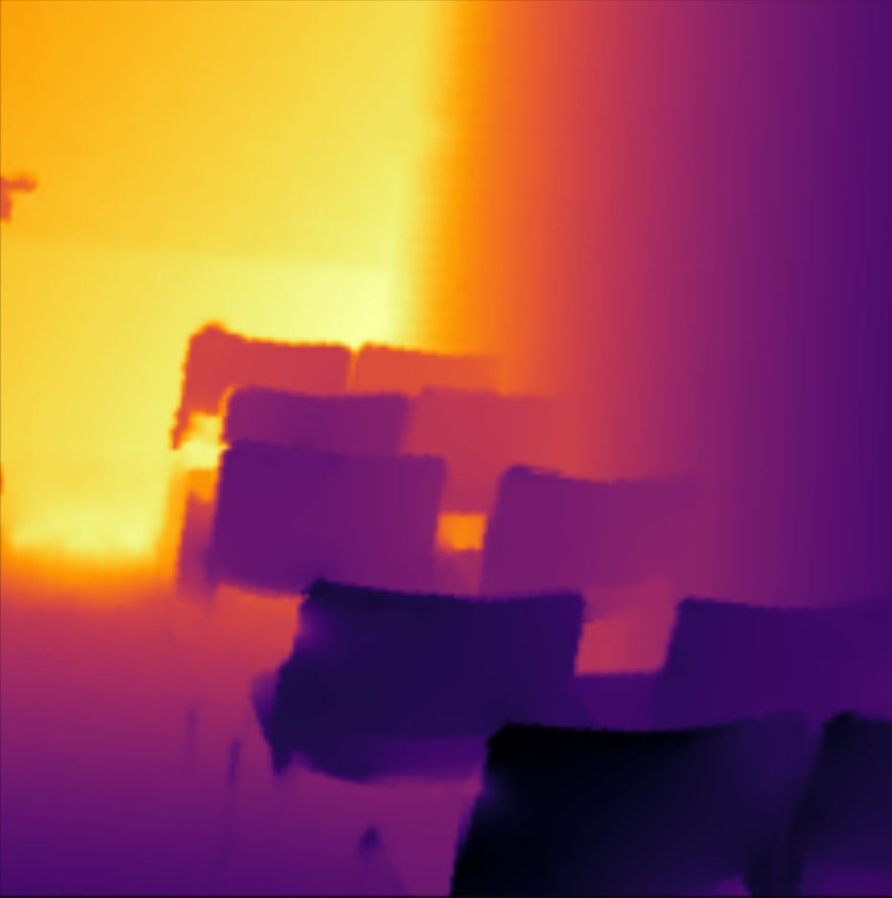
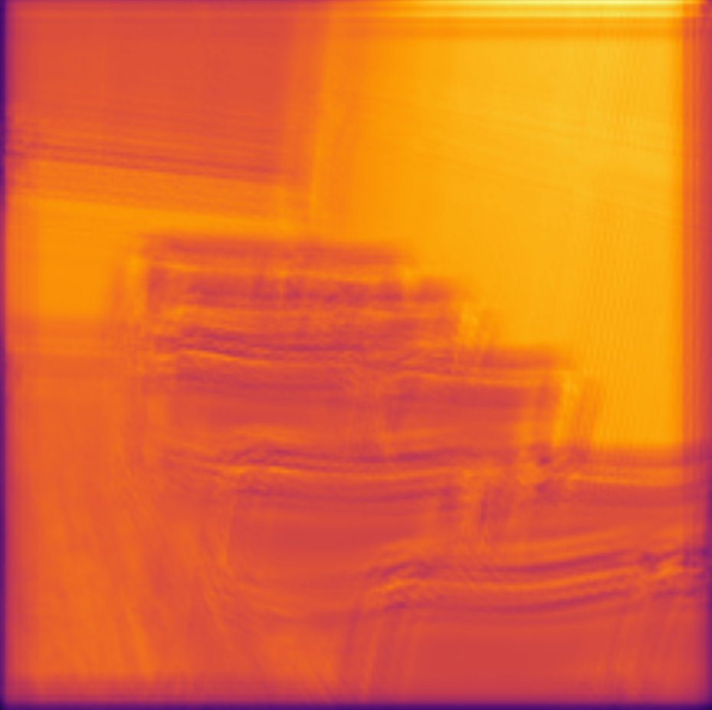
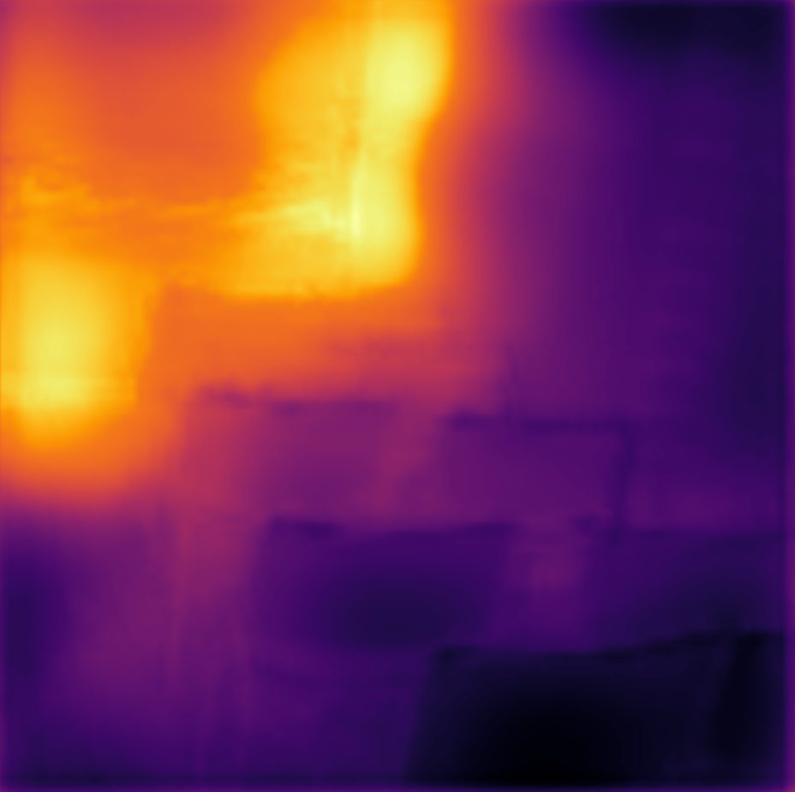
Input RGB
Depth Ground Truth
Baseline Model
Final Model
Notes:
Here is a comparison of the baseline and final model on test samples. The baseline model is able to extract more structural elements from the color image, but fails miserable at accurately predicting depth, as it seems to rely too much on brightness for its prediction. On the other hand, the final model is a little blurry but is able to accurately predict the depth of different areas in the image.

Slide 19


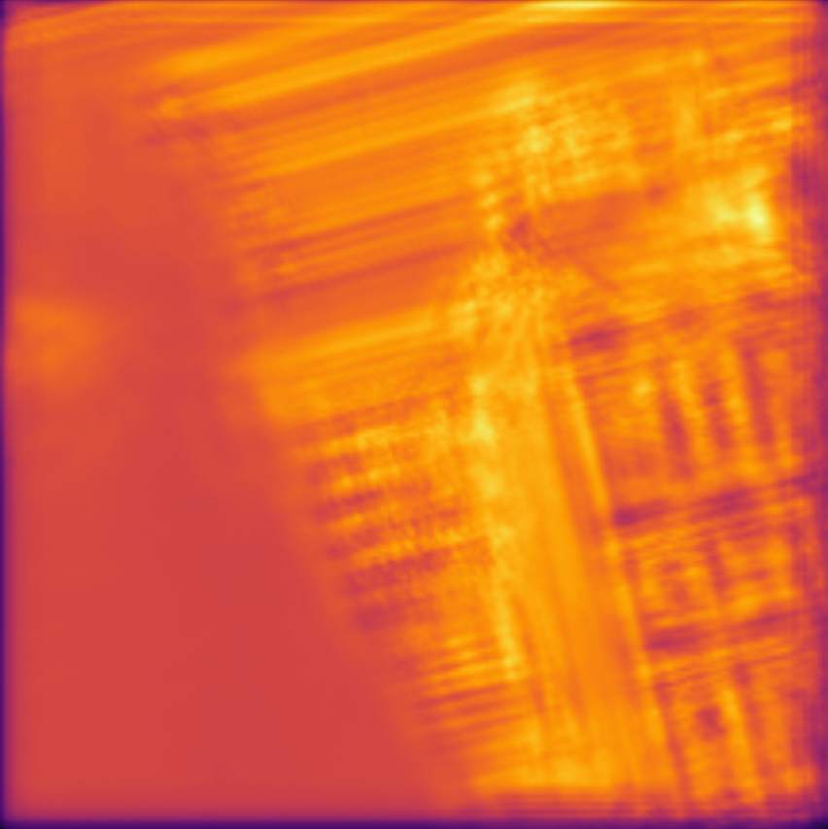
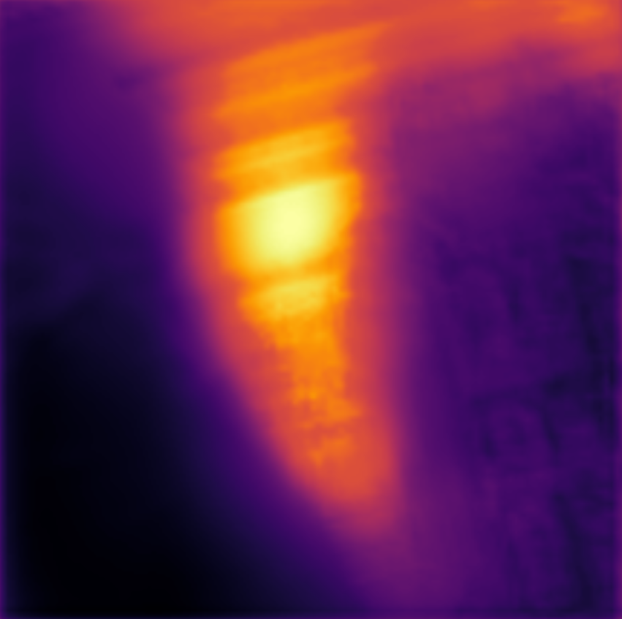
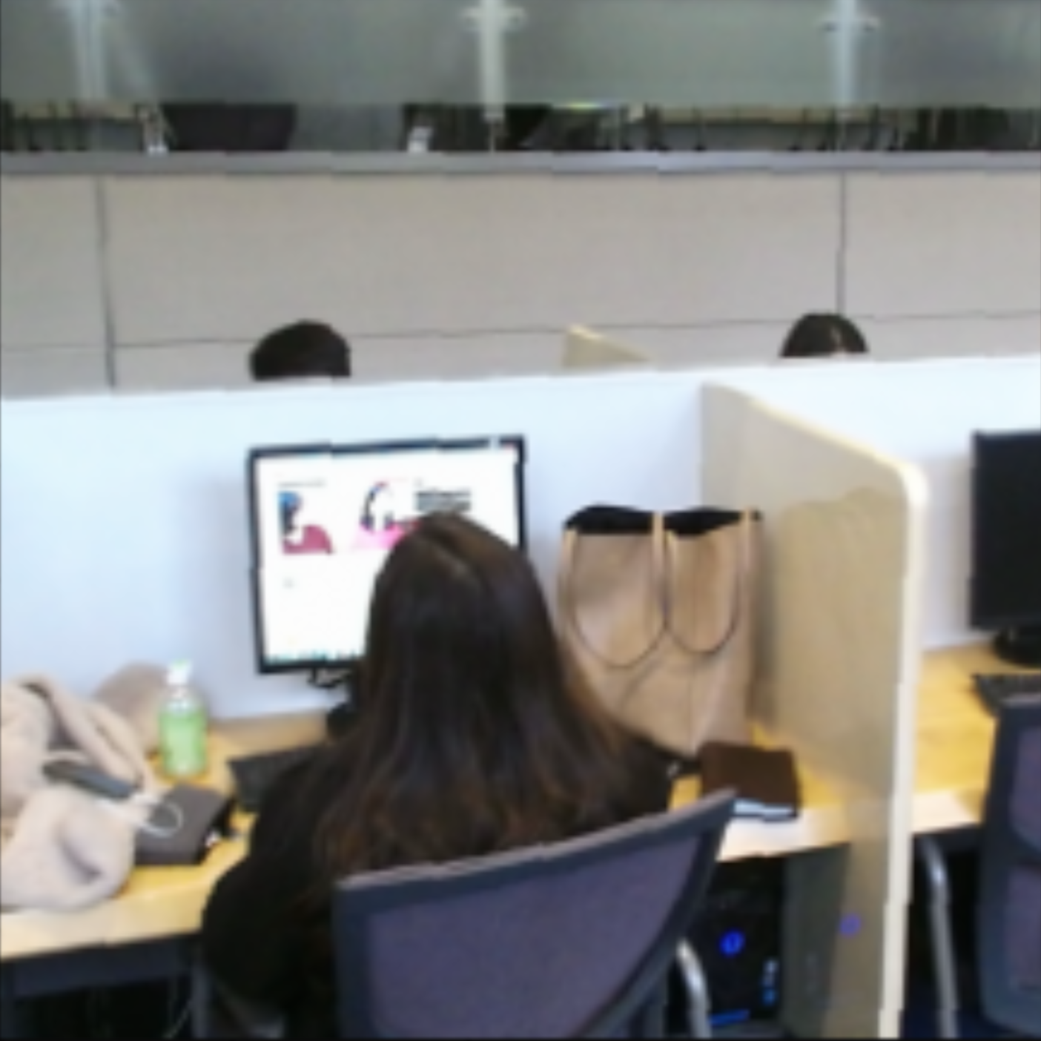
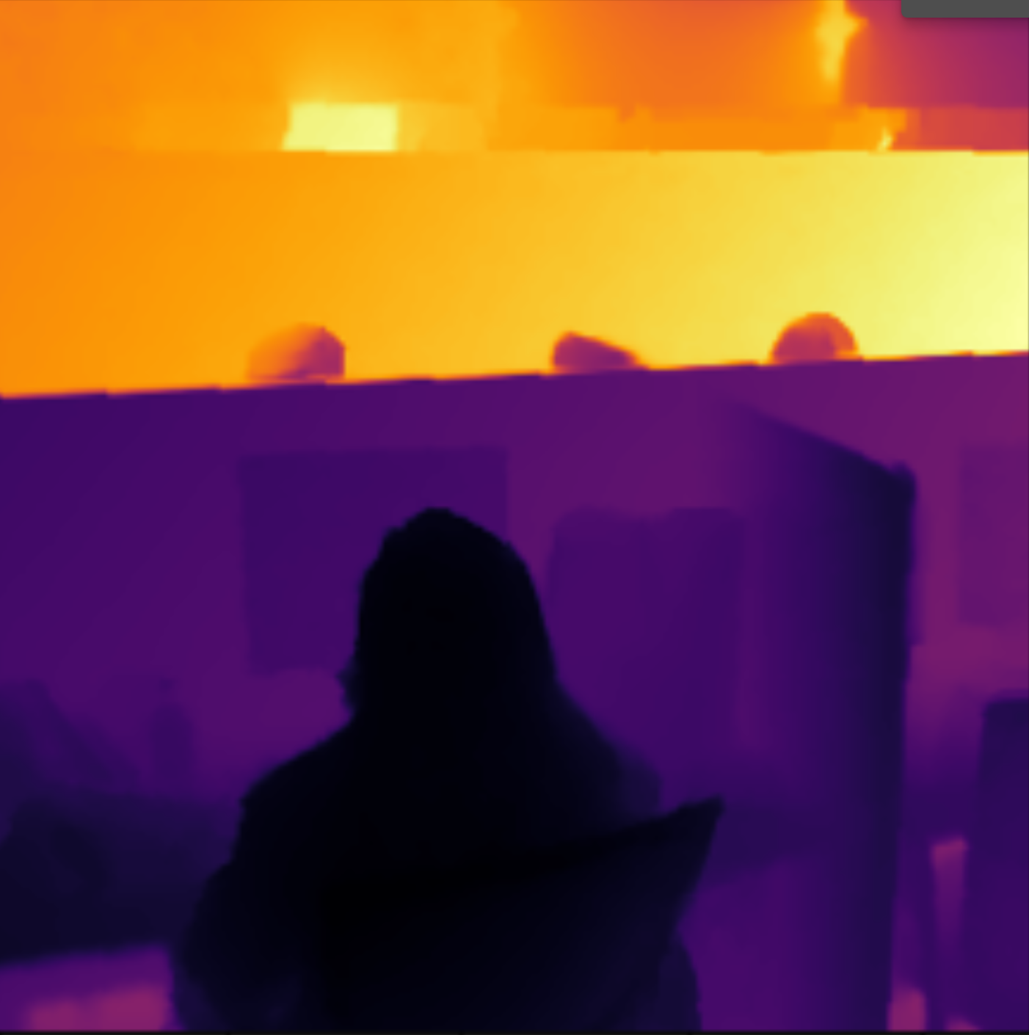
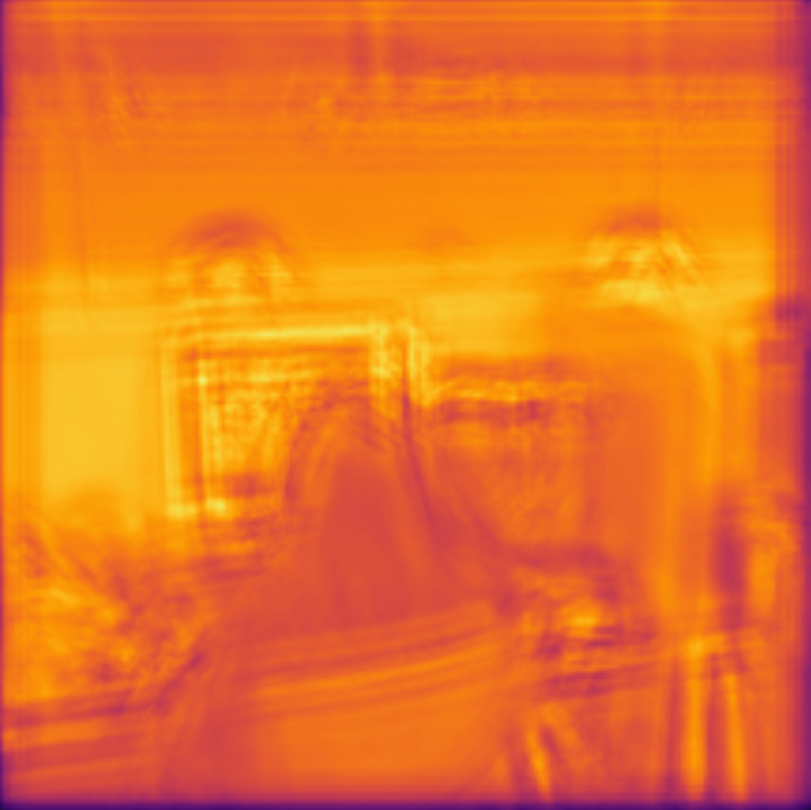
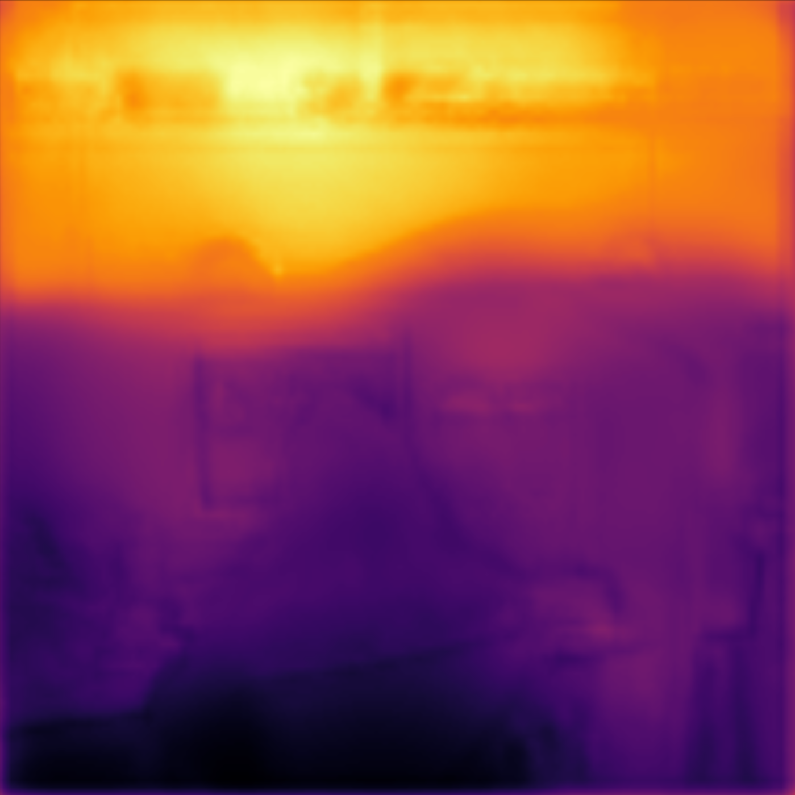
Input RGB
Depth Ground Truth
Baseline Model
Final Model
Notes:
Here is a comparison of the baseline and final model on test samples. The baseline model is able to extract more structural elements from the color image, but fails miserable at accurately predicting depth, as it seems to rely too much on brightness for its prediction. On the other hand, the final model is a little blurry but quite accurately

Slide 20
Key Findings
Importance of
a suitable data source
Performance Capability of Skip Connections
Difficult Application in Real-World Settings
Depth Est.
Importance
Data Proc. & Collection
Architecture
Demo
Performance
Takeaways
Notes:
One observation our team members made is that finding a suitable data source is very important, and a dataset should be only be selected after a thorough examination of all available options. As choosing the NYU dataset initially led to the generation of inaccurate depth maps of rgb images, due to the dataset containing significant noise and missing features.
//**A lot of time was initially spent on the NYU dataset, which contained significant noise and had missing features in the ground truth maps. As a result, our training progress was hindered as poor ground truth images led to the generation of inaccurate depth maps of rgb images.**//
Further, our team noticed the major improvement in performance yielded by utilizing skip connections in an Autoencoder coupled with transfer-learning. The model with skip connections succeeded in extracting significantly more details when compared to our baseline model comprising of simple convolutions, thus providing much higher quality depth mappings.
It is also important to note the difficulty in applying a monocular depth estimation ML model to a real world application. Despite our team experimenting extensively with a wide range of models including Autoencoders, GANs, cGANs and skip connections, our best model occasionally fails to accurately identify the depth of certain objects in settings where there are a large number of objects in the foreground. This may lead to potentially hazardous situations in a real world application such as obstacle detection using depth estimation in self-driving vehicles.

Slide 21
Questions?
Notes:
Thank you for listening to our presentation, we would be happy to take any questions.

